Slide 1
Web Development using React js
Lecturer name
Lecturer
Faculty of Computer & IT
Jamahiriya University of Science & Technology

Slide 2
Chapter #3
State and Lifecycle
Handling Events Rendering
Conditional Rendering
Lists and Keys
Foundations of react

Slide 3
State and Lifecycle
State allows us to manage changing data in an application. It's defined as an object where we define key-value pairs specifying various data we want to track in the application.
In React, all the code we write is defined inside a component.
There are mainly two ways of creating a component in React as we learned last chapter.
class-based component.
functional component.

Slide 4
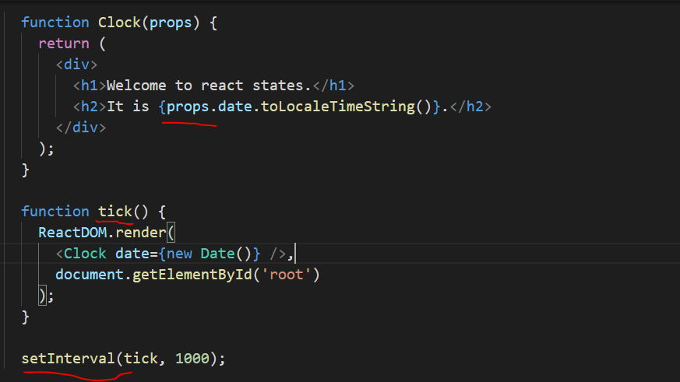
State and Lifecycle
Consider the following example

Slide 5
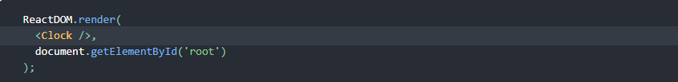
State and Lifecycle
However, it misses a crucial requirement: the fact that the Clock sets up a timer and updates the UI every second should be an implementation detail of the Clock.
Ideally we want to write once and have the Clock update itself.

Slide 6
State and Lifecycle
To implement calling once, we need to add state to the Clock component.
State is similar to props, but it is private and fully controlled by the component.
Converting a Function to a Class in five steps
Create an ES6 class, with the same name, that extends React.Component.
Add a single empty method to it called render().

Slide 7
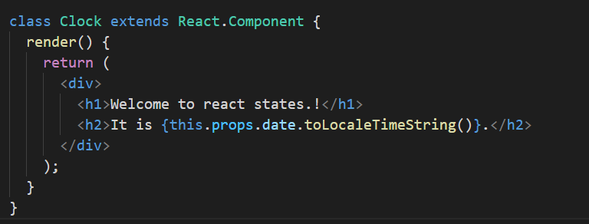
State and Lifecycle
Move the body of the function into the render() method.
Replace props with this.props in the render() body.
Delete the remaining empty function declaration.

Slide 8
State and Lifecycle
Clock is now defined as a class rather than a function.
The render method will be called each time an update happens, but as long as we render <Clock /> into the same DOM node, only a single instance of the Clock class will be used.
This lets us use additional features such as local state and lifecycle methods.

Slide 9
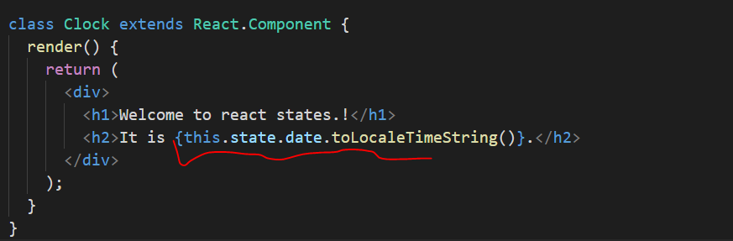
State and Lifecycle
Adding Local State to a Class
We will move the date from props to state in three steps:
Replace this.props.date with this.state.date in the render() method:

Slide 10
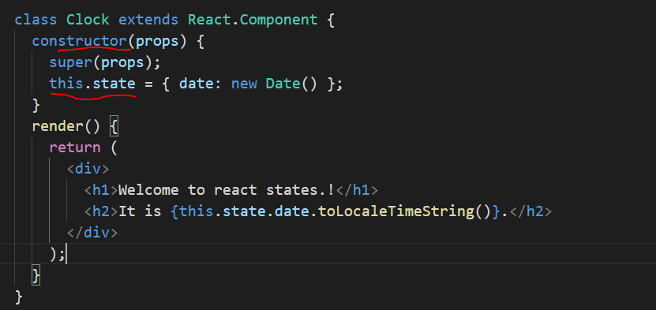
State and Lifecycle
Adding Local State to a Class
Add a class constructor that assigns the initial this.state:

Slide 11

State and Lifecycle
Adding Local State to a Class
Remove the date prop from the <Clock /> element:
Next, we’ll make the Clock set up its own timer and update itself every second.

Slide 12
State and Lifecycle
Adding Lifecycle Methods to a Class
In applications with many components, it’s very important to free up resources taken by the components when they are destroyed.
We want to set up a timer whenever the Clock is rendered to the DOM for the first time. This is called mounting in React.
We also want to clear that timer whenever the DOM produced by the Clock is removed. This is called unmounting in React.
We add special methods on the component class to run some code when a component mounts and unmounts.

Slide 13
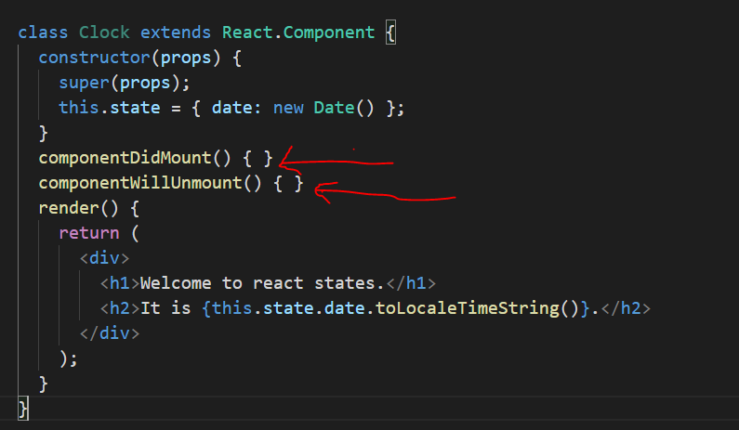
State and Lifecycle
Adding Lifecycle Methods to a Class

Slide 14
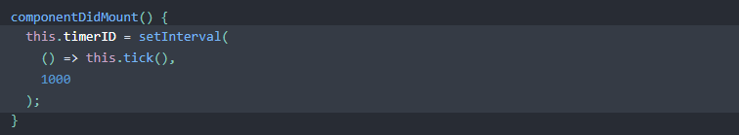
State and Lifecycle
Adding Lifecycle Methods to a Class
The newly added methods are called lifecycle methods.
The componentDidMount() method runs after the component output has been rendered to the DOM. This is a good place to set up a timer.

Slide 15

State and Lifecycle
Adding Lifecycle Methods to a Class
We will tear down the timer in the componentWillUnmount() lifecycle method.

Slide 16
State and Lifecycle
Adding Lifecycle Methods to a Class
We will tear down the timer in the componentWillUnmount() lifecycle method.
Finally, we will implement a method called tick() that the Clock component will run every second.

Slide 17
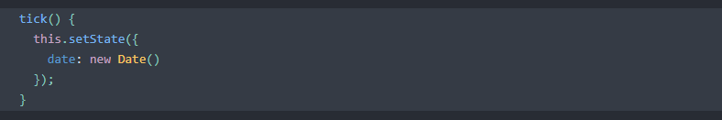
State and Lifecycle
Adding Lifecycle Methods to a Class
It will use this.setState() to schedule updates to the component local state.

Slide 18
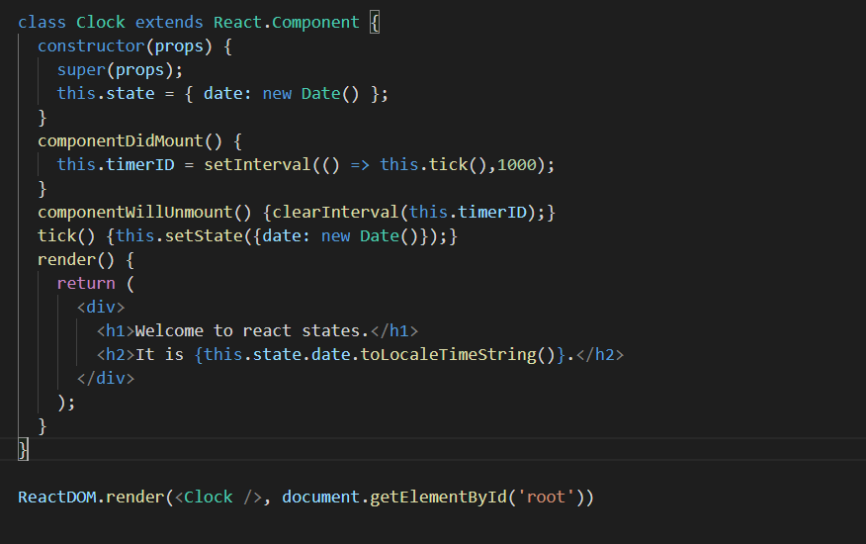
State and Lifecycle

Slide 19
END.

